Slide 1

Academic Anxiety
October 5th, 2021

Slide 2

Meet Sarah!

Slide 3
Meet Sarah!
Sarah is a first-year student at Wake Tech. The courses she’s taking include:
ENG-111-Writing and Inquiry
MAT-171-Precalculus Algebra
BIO-111-General Biology I
PHI-240-Introduction to Ethics
It’s almost midterms and she has a lot of work due.

Slide 4



Can Sarah Succeed in a College Environment?
Sarah has been out of school for many years.
She has struggled with math and writing in the past.
She works part-time and she has two young children.

Slide 5
Can Sarah Succeed in a College Environment? YES!
She will need to practice:
Time Management
Mindfulness
Prioritization of tasks
We can help!-Wake Tech ILC, counseling center

Slide 6
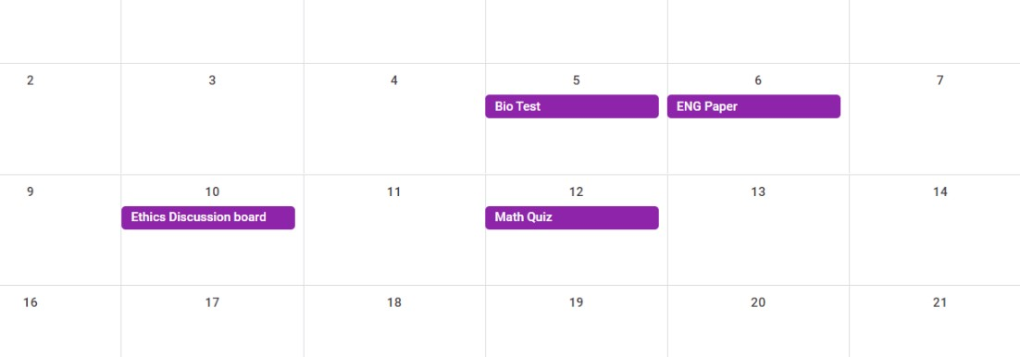
Make a Calendar!

Slide 7
Using the calendar to plan your studies
What should Sarah do to plan for the next week?
Focus on what’s due first, first
Break tasks down into manageable chunks
Work on some chunks of each assignment
If you can, finish one task before starting another

Slide 8
Saturday October 1st
Get started on paper-brainstorm, research, write beginning.
Take a break
Study for bio-plan what you will focus on when
Book appoints for ILC, counseling center, or with instructor as soon as you can.

Slide 9
Sunday October 2nd
Do more work on the paper-Finish rough draft
Take a break
Study for bio-focus on a different topic

Slide 10
Monday October 3rd
Look over bio notes-focus on a different topic
Go to work
Work on essay-revise and edit
Go to bio tutoring appointment at ILC

Slide 11
Tuesday October 4th
Study for bio-revisit topics you have already studied
Go to work
Review your paper and make improvements
Get a good night sleep

Slide 12
Wednesday October 5th
Complete a final review bio notes-don’t cram!
Take Bio test
Finish up paper
Go to ILC writing appointment to discuss paper

Slide 13
Thursday October 6th
Turn in essay
Go to work
Begin plan for studying for math
Look at other ethics discussion board entries for ideas

Slide 14
Friday October 7th
Study for math
Brainstorm ethics discussion board
Go to counseling center appointment to discuss anxiety.

Slide 15
Saturday, October 8th
Study for math-focus on a different topic
Write a rough draft of ethics discussion board
Go to online ILC math appointment

Slide 16
Sunday, October 9th
Study for math-focus on a different topic
Revise and edit discussion board entry
Look ahead to upcoming English and bio assignments

Slide 17
Monday, October 10th
Review math topics
Go to work
Make biology study plan

Slide 18
Tuesday, October 11th
Review math topics
Go to work
Begin studying for future biology test
Get a good night sleep

Slide 19
Wednesday, October 12th
Take math test
Begin planning for future English paper
Study for bio-focus on a different topic

Slide 20

Success!
By following this schedule, Sarah did well on all of her assignments

Slide 21
A few more tips for dealing with anxiety
While time management helps reduce anxiety, here are some other strategies to consider.

Slide 22
Anxiety on exam days
Make sure to eat before the test
Get a good night sleep
Study in advance
Don’t cram

Slide 23
Focus on the present-Mindfulness
If you think of things you need to do, write it down so that it doesn’t distract you.
Try to find a place that is comfortable to you.
Take breaks to catch your breath
Speak positively to yourself- “You can do this” “Just one more thing to do.”

Slide 24
Outside of your studies
Managing your time can help with anxiety
Plan out multiple presentations
Maintain work/life balance.

